Slide 1

Discover the Digiposte mobile application
2025 presentation

Slide 2
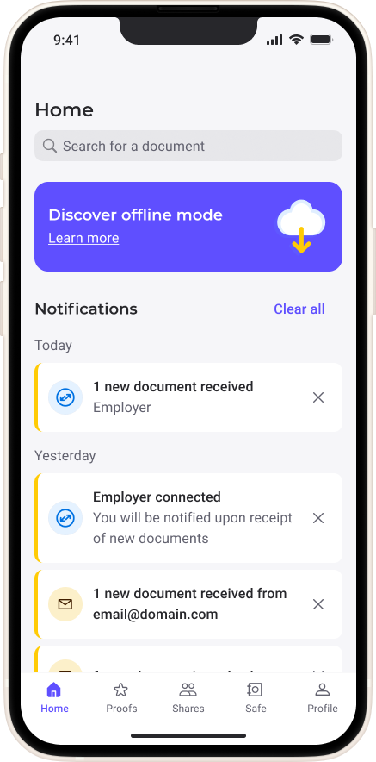



Thanks to its intuitive interface and features you can access your documents securely, sort and file them, and use them whenever you need to.
Download the Digiposte mobile application to access all its features and enjoy the following benefits:
The Digiposte application simplifies the management of your administrative documents
Security
Authenticity
Hosted in France

Slide 3
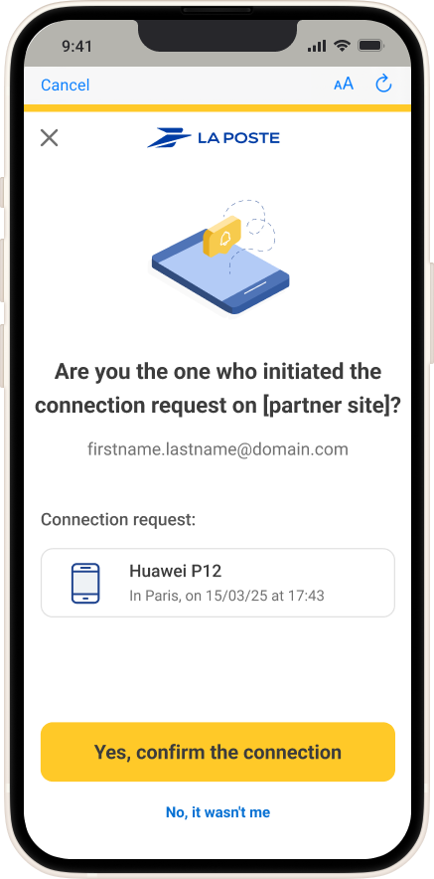
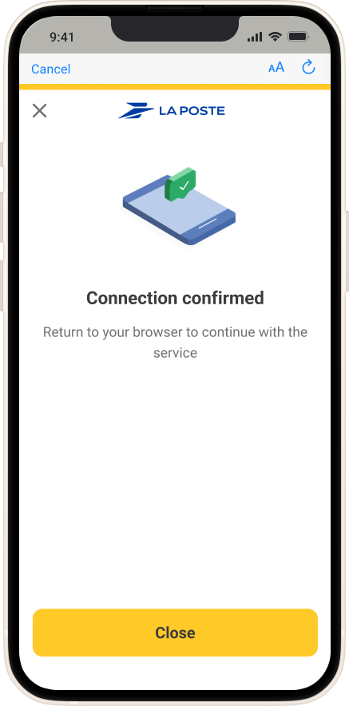
Two-factor authentication secures your connections
Push two-factor authentication allows you to verify your identity directly from the Digiposte mobile application
How does it work?
You receive a notification on your Digiposte application to confirm your identity and authorize access to the La Poste service you wish to log in to.

Slide 4
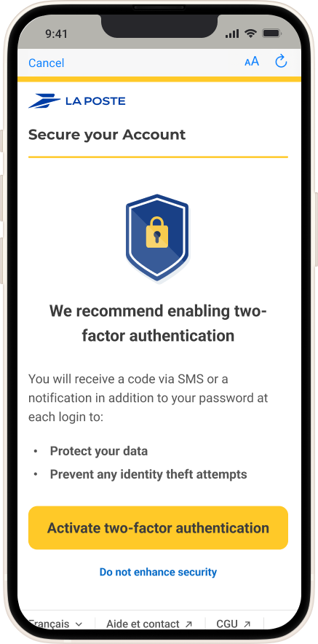
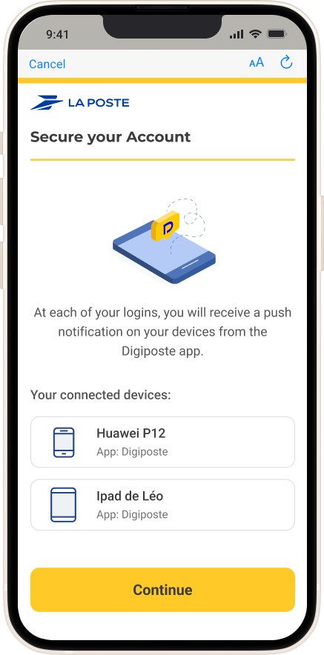
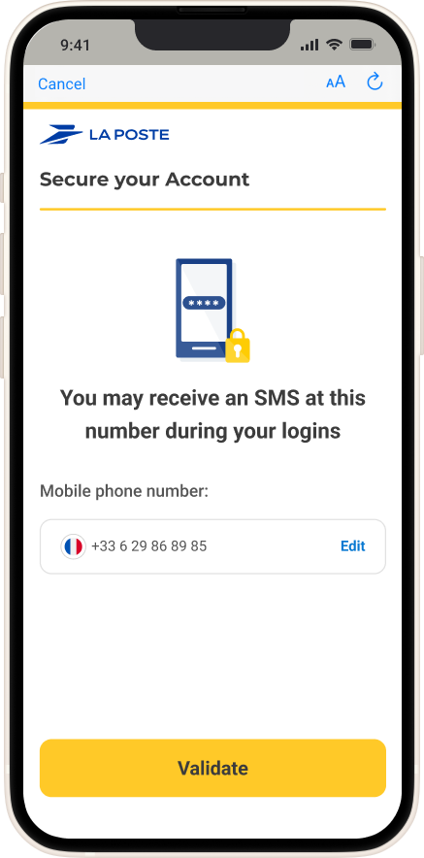
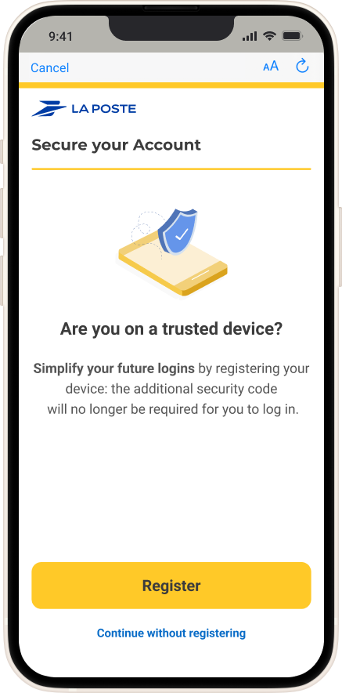
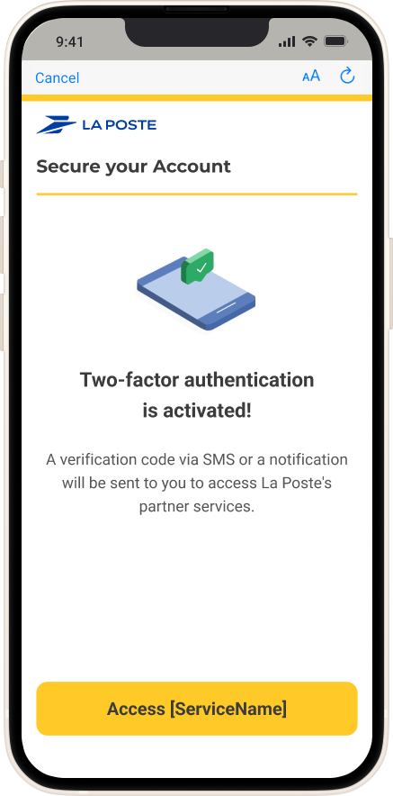
Spotlight on push two-factor authentication activation
When you first first connection to Digiposte, we recommend that you activate two-factor authentication
Your Digiposte-connected devices appear. Click "Continue"
Enter your cell phone number to receive an SMS whenever you log on
Click "Register" to activate push two-factor authentication on your mobile app
Well done!
Push 2FA is activated.
From now on, you will receive a notification on your mobile application when you connect to La Poste partner sites

Slide 5
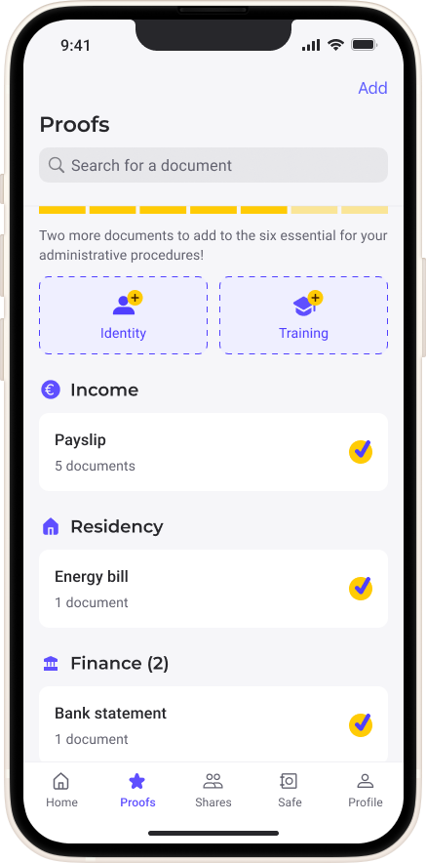
Find your important documents quickly with receipts
The "Supporting documents“ section allows you to quickly access your important documents such as payslips, certificates and other supporting documents.
Quick access from the menu: you can easily find your most important documents thanks to a sorting system that highlights your payslips. No need to look for them!
Add important documents: Digiposte can help you add any documents you haven't already stored to your digital safe.

Slide 6
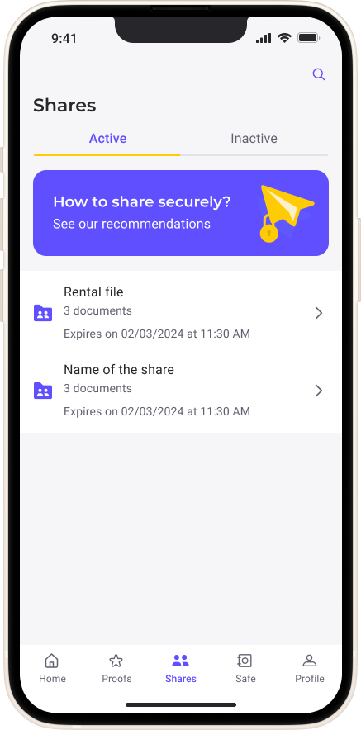
Share your documents securely with third parties
The "Sharing" section contains all the documents you share with third parties (for example, a rental file, a proof of address, etc.).
A few tips for safe sharing:
Prioritize PDFs for sharing
Share only the documents you need
Add a secure code
Set a due date
View notifications related to the documents you’ve shared

Slide 7
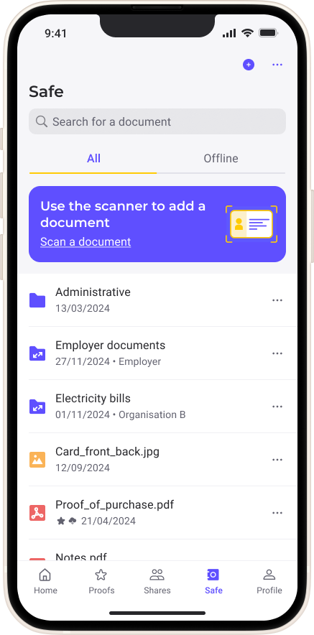
Quick access to all your documents in your safe
Direct access to documents: no need to rummage around, you have direct access to your documents and files, organized to facilitate day-to-day management.
Offline mode highlighted (on the paid version):from the top-right tab, you have easy, secure access to your documents, wherever you are.
Add documents: add your important documents from the safe using the scanner, manual import or agency connection. Whether it's invoices, contracts or personal documents, you won't have to rummage through filing cabinets or e-mails.

Slide 8
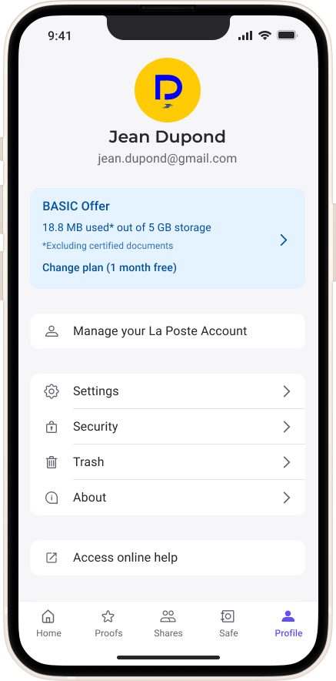
Manage your personal information and preferences from your profile
The advantages of the current package and the possibility of switching to the Premium or Professional package
Managing login details ( e-mail, password, La Poste account telephone number)
Setting up your Digiposte( notifications, consent, deletion, etc.)
The security of your Digiposte (connection history, two-factor authentication and unlocking mode)
About Digiposte (legal information, terms of use, data security, etc.)

Slide 9
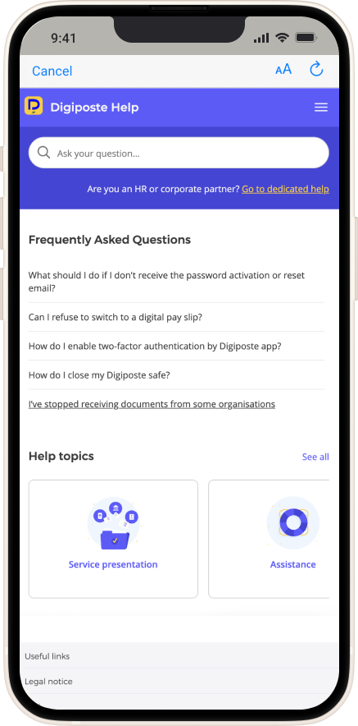
All the answers to your questions on our dedicated user support site
Find all the answers to your questions in the online guide available from your profile.
Access tips and advice to help you manage your administrative procedures

Slide 10
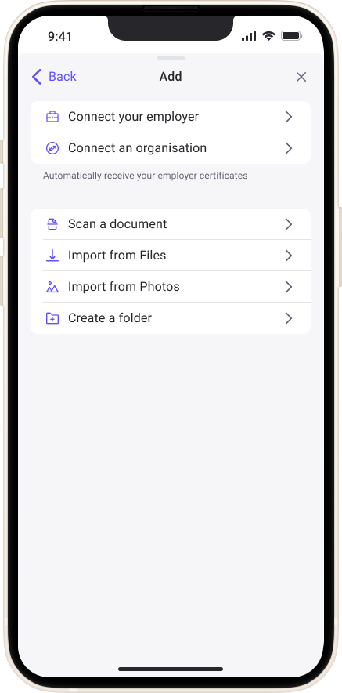
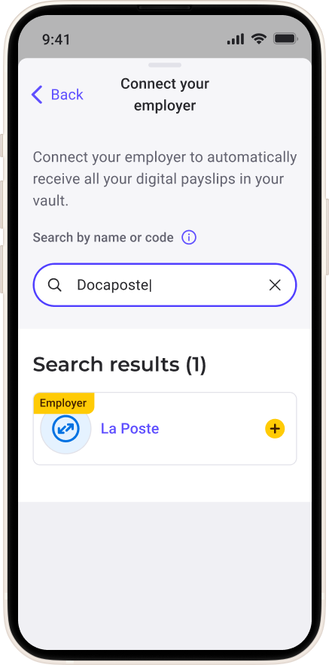
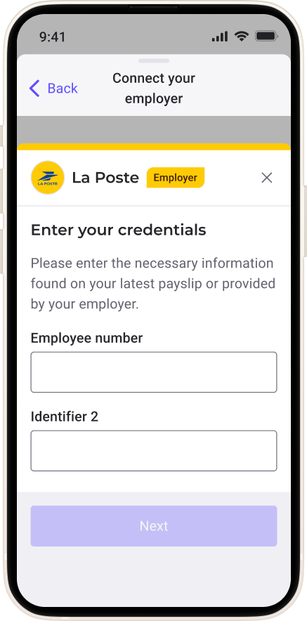
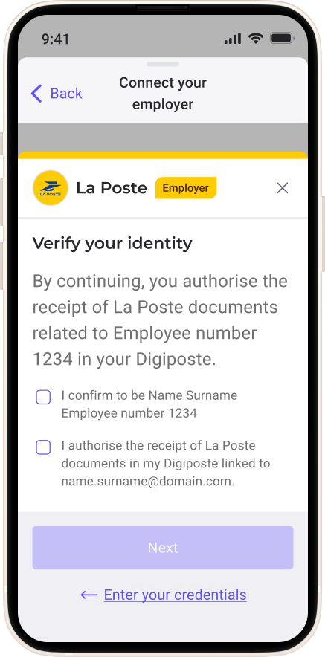
Spotlight on adding your employer
Use the "+" or "add" button on the "supporting documents " or "safe“ pages, click "Connect your employer"
Search for your employer using the search bar
Enter your login details to confirm your identity
If you do not have your login details, please contact your employer
Check your identity to authorise your Digiposte safe to receive documents from your employer

Slide 11
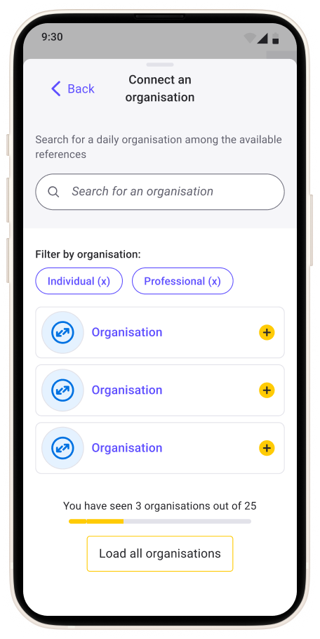
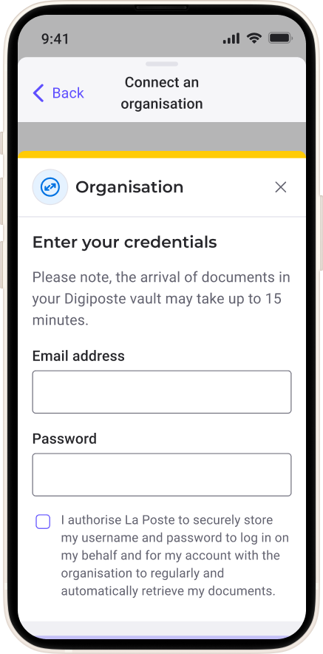
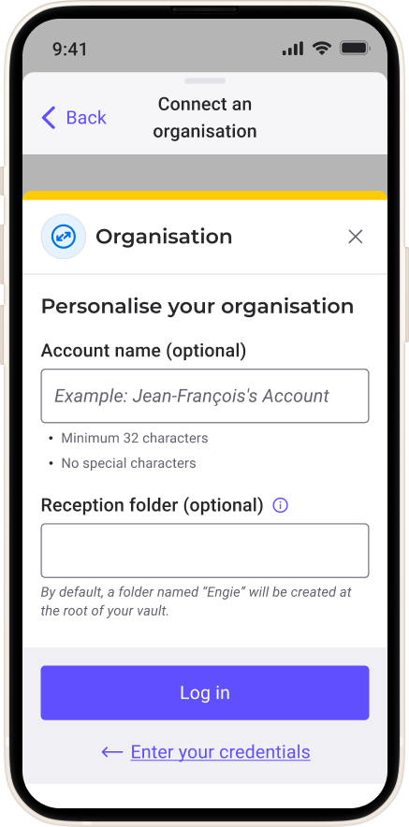
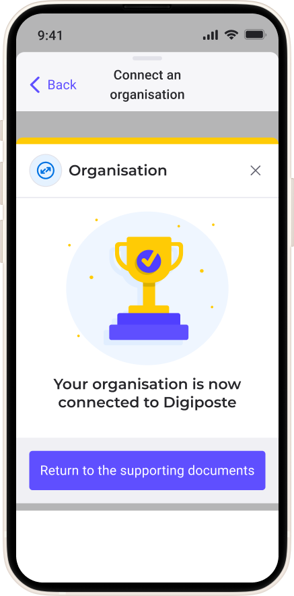
Spotlight on adding an organization
Use the "+" or "add" button on the "supporting documents " or "safe“ pages, click "Connect an organization"
Search for your organization using the search bar
Enter your usual login details
Personalize your organization and choose the folder location in your safe
Your organization has been successfully set up.
From now on you will receive all your documents directly in Digiposte

