Slide 1

How can I refuse to have my payslip sent electronically?
With the "refusal collection assistance" option
TUTORIAL - 2025

Slide 2
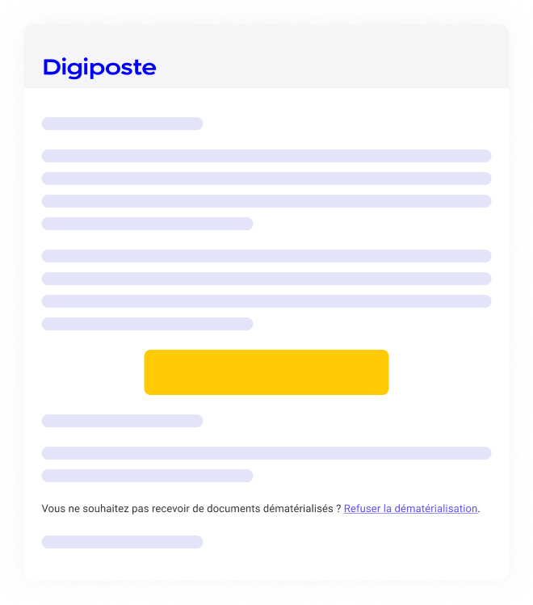

Refuse to use electronic documents via a dedicated procedure
To refuse to use electronic documents, follow the link at the bottom of the invitation e-mail or go to the dedicated URL (provided by your company).
Make sure you have your login details to hand (provided by your employer) and follow the instructions. A step will tell you whether or not you have any documents to retrieve.
The dedicated URL usually looks like this:
https://adherer.digiposte.fr/nomdelentreprise

Slide 3

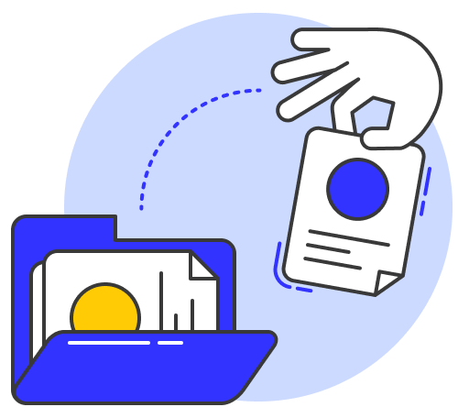
There are 2 possible scenarios for refusing to use electronic documents
Scenario 1
Scenario 2
You have not yet received a document in Digiposte
You have already received a document
in Digiposte
Your company informs you that your next payslip will be deposited in Digiposte (usually 1 month before or at the time of hiring).
Retrieve your documents and refuse to accept new ones.

Slide 4
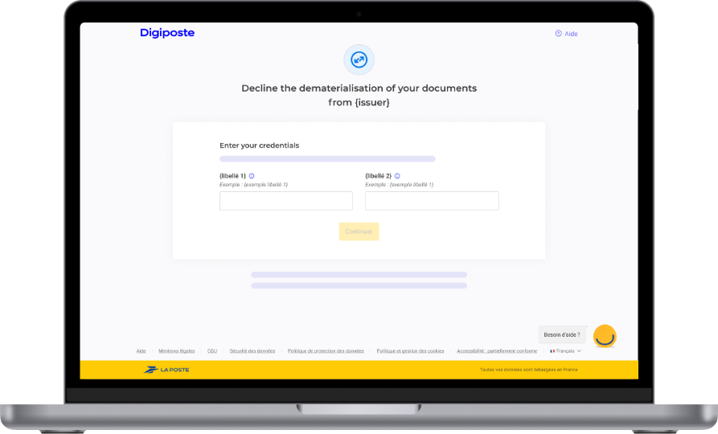
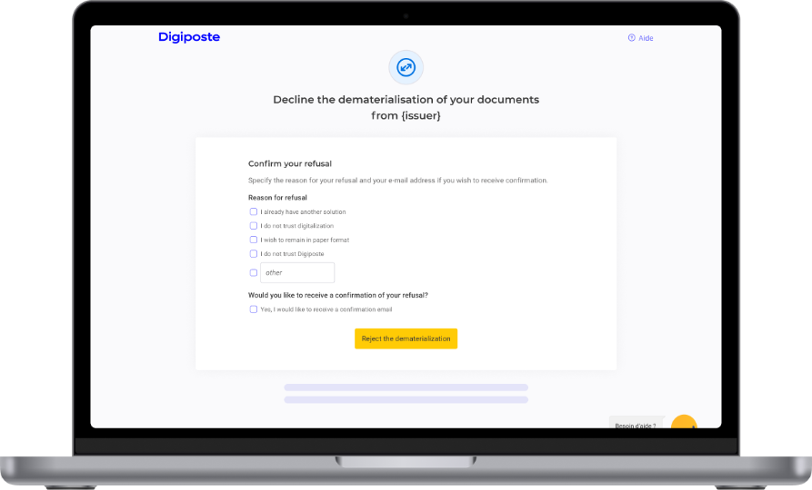
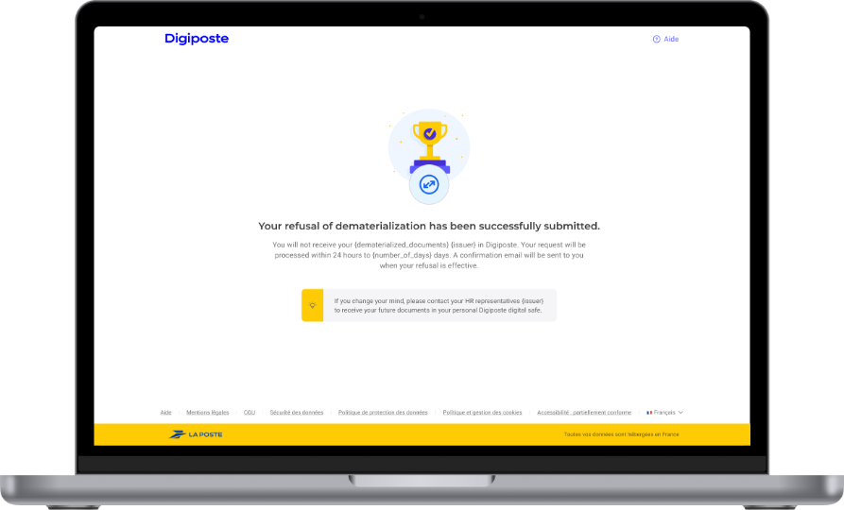
You have not yet received a document in Digiposte
Scenario 1
Enter theURL dedicated to your company to refuse to use electronic documents and follow the steps.
Your local HR will be able to provide you with the URL.
Digiposte has sent you an e-mail to create your safe. You can access the dedicated URL by clicking on the link at the bottom of the e-mail.
Enter your identification number and EK code (shown at the top right of your payslip).
Please explain your reason for refusal and confirm your refusal.
A confirmation e-mail will be sent to you when your refusal becomes effective.

Slide 5
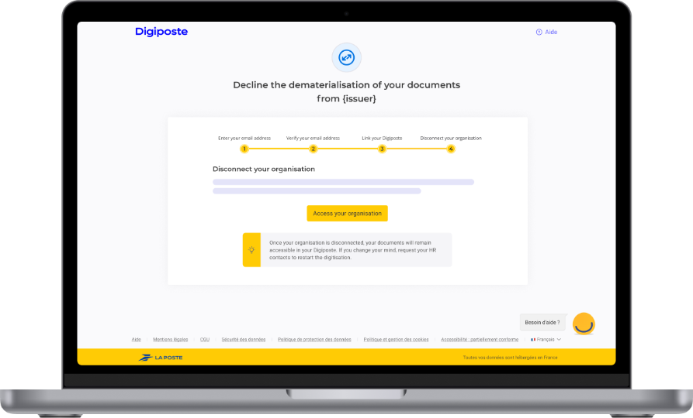
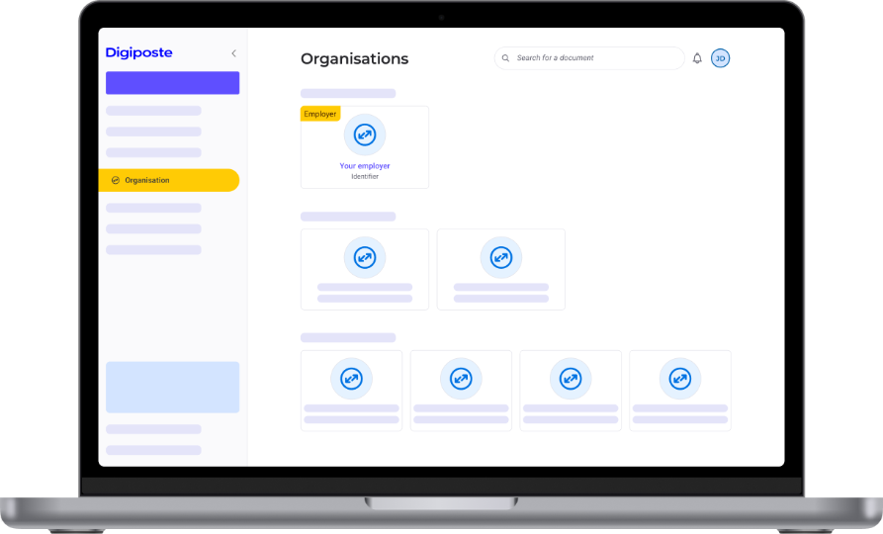
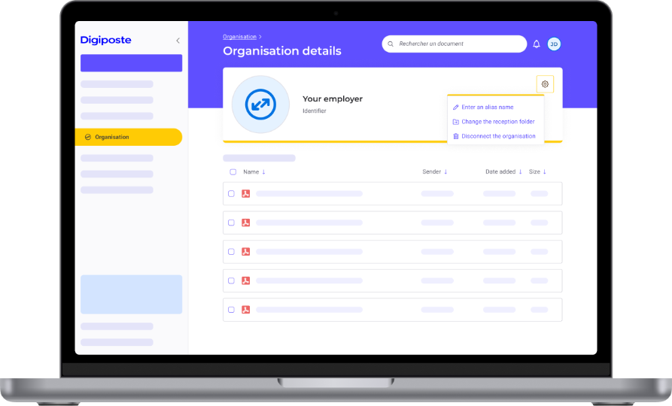
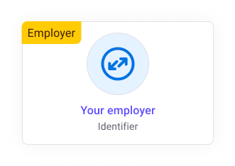
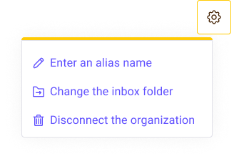
You have already received a document in Digiposte
Scenario 2
When documents have already been sent, you need to register with Digiposte to retrieve them. You can then refuse to receive new documents from the Organizations section.
You will receive your payslips again in printed form no later than 62 days after you disconnect from the organisation.
Activate your Digiposte safe from the e-mail invitation or from the URL dedicated to your company.
Go to the Organizations section, click on your employer and download your documents.
Click on the organisation's settings to disconnect it.

