Slide 1

How can I refuse to have my payslip sent electronically?
TUTORIAL – 2025

Slide 2
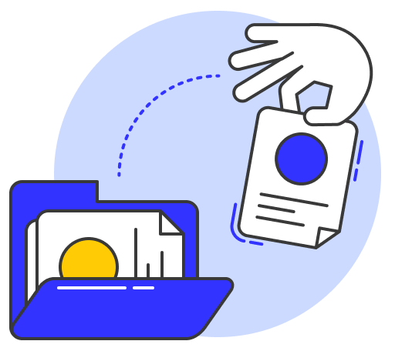


There are 2 possible scenarios for refusing to use electronic documents
Scenario 1
Scenario 1
Scenario 2
Scenario 2
You have not yet received a document in Digiposte
You have not yet received a document in Digiposte
You have already received a document
in Digiposte
You have already received a document
in Digiposte
Your company informs you that your next payslip will be deposited in Digiposte (usually 1 month before or at the time of hiring).
Your company informs you that your next payslip will be deposited in Digiposte (usually 1 month before or at the time of hiring).
Make sure you have your login details to hand (provided by your employer) and follow the instructions.
Make sure you have your login details to hand (provided by your employer) and follow the instructions.

Slide 3




You have not yet received a document in Digiposte
Scenario 1
Notify your employer that you do not wish to receive your payslip in digital format at any time before the first deposit of the digital payslip in Digiposte by:
You've changed your mind and want to receive your payslips in Digiposte?
Don't worry, you can inform your employer at any time that you wish to receive your documents in Digiposte. They can then create your personal safe.
Online form
Mail (e-mail or post)
Good to know
Document sent by your company
If you have not notified your employer of your objection before the first document submission, you will automatically receive your next payslip in Digiposte.
Any other means

Slide 4
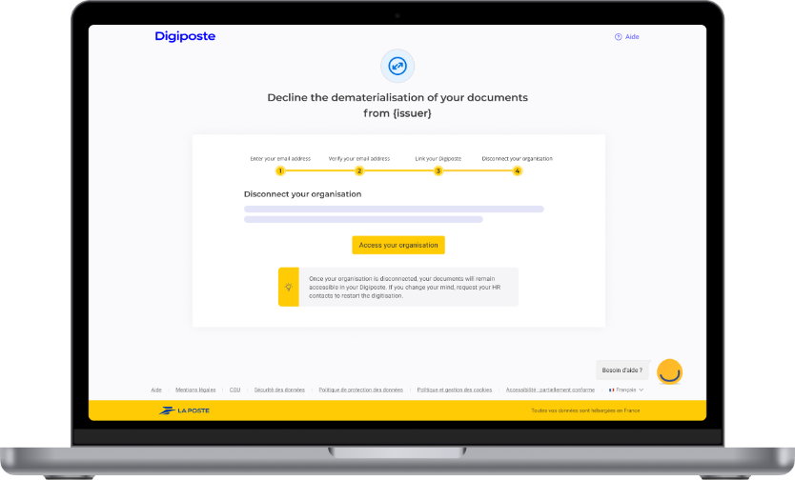
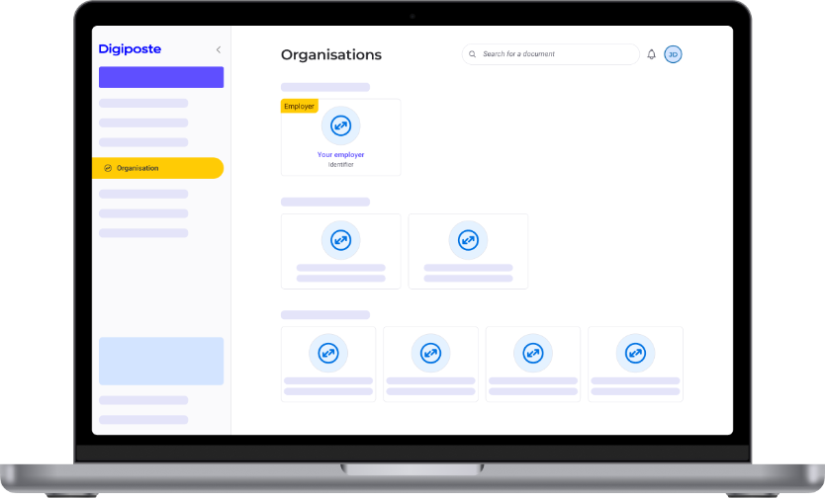
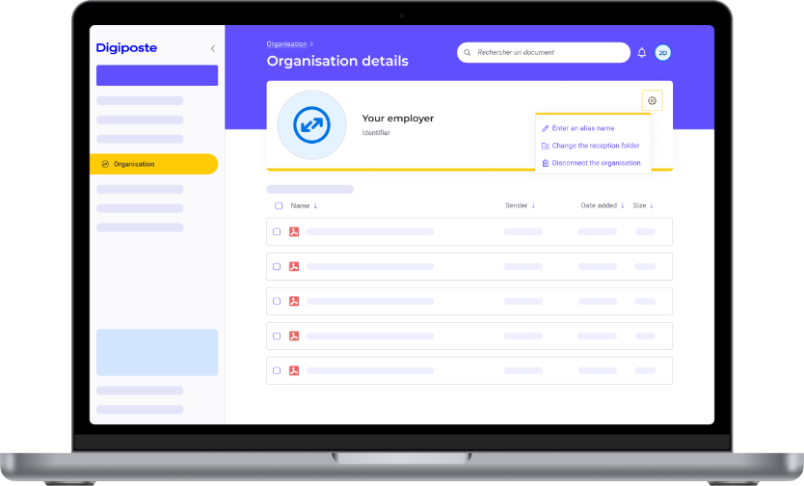
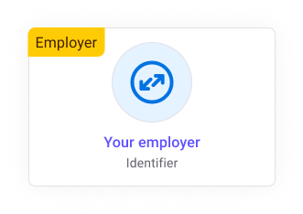
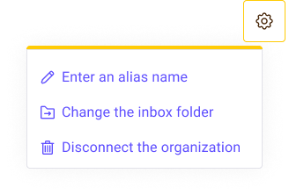
You have already received a document in Digiposte
Scenario 2
When documents have already been sent, you need to register with Digiposte to retrieve them. You can then refuse to receive new documents from the Organizations section.
You will receive your payslips again in printed form no later than 62 days after you disconnect from the organisation.
Activate your Digiposte safe from the e-mail invitation or from the URL dedicated to your company.
Go to the Organizations section, click on your employer and download your documents.
Click on the organisation's settings to disconnect it.

