Slide 1

Improve your employees' experience by depositing your payslips in Digiposte
2025 presentation
Notes:
TEST TEST TEST

Slide 2


Your employees' payslips in Digiposte
To simplify the administrative procedures of your employees, you have chosen to deposit their payslips each month in their secure Digiposte digital safe.
Digiposte has no access to the documents deposited in their safe!

Slide 3



What are the advantages of Digiposte?
Simple​
Secure
Confidential
Digiposte makes it easy to centralize important important documents to make administrative procedures easier for your employees.
Digiposte connections are secured with anti-intrusion systems and double authentication.
Service managed by La Poste which guarantees hosting 100% in France, security, durability and confidentiality of documents

Slide 4
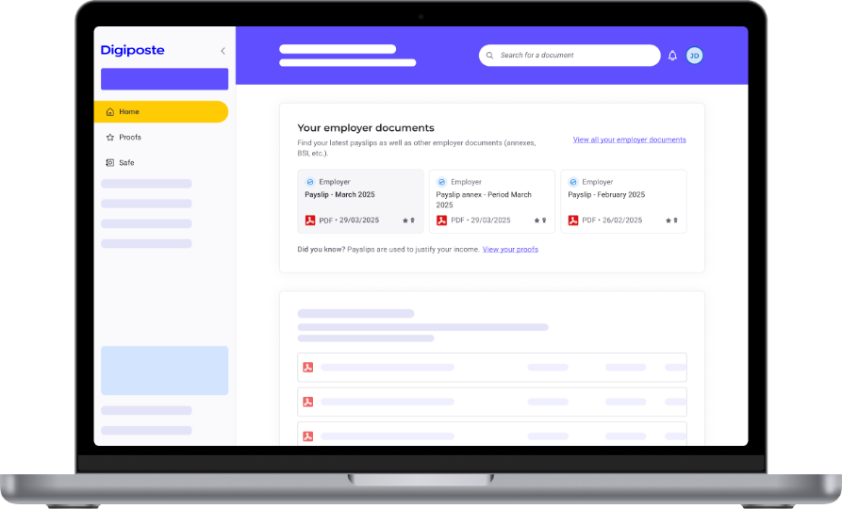



Original documents deposited
Your documents deposited in digital safes have the same value as a printed document and include:
A level of certification​
Certified (original document with identified sender) or uncertified (manual addition by user).
A document format​
Payslips are PDF documents. Users can add other document types.
Document details
Employer name, filing date, document title, weight and type of document.

Slide 5



3 different and complementary enrollment paths
Digiposte offers 3 complementary enrollment paths to suit various company configurations:
PURL
ACCES DIRECT
SPONTANEOUS ENROLLMENT
#WITH EMAIL
#WITHOUT EMAIL
#DIGIPOSTE VAULT
The most commonly used by our clients.
The employer must have their employees' email addresses.
Employees receive a personalized and unique email from Digiposte inviting them to activate their digital vault.
Ideal for companies without user email addresses.
Employees access a dedicated URL shared by the company.
Example: adherer.digiposte.fr/entreprise
For users already registered on Digiposte.
They can add their employer to their existing vault.
Only one authentication is needed to automatically receive documents from the employer.
+
Only one code is required to complete activation.
+
Two codes are required to secure activation
+
Two codes must be entered when adding the employer

Slide 6
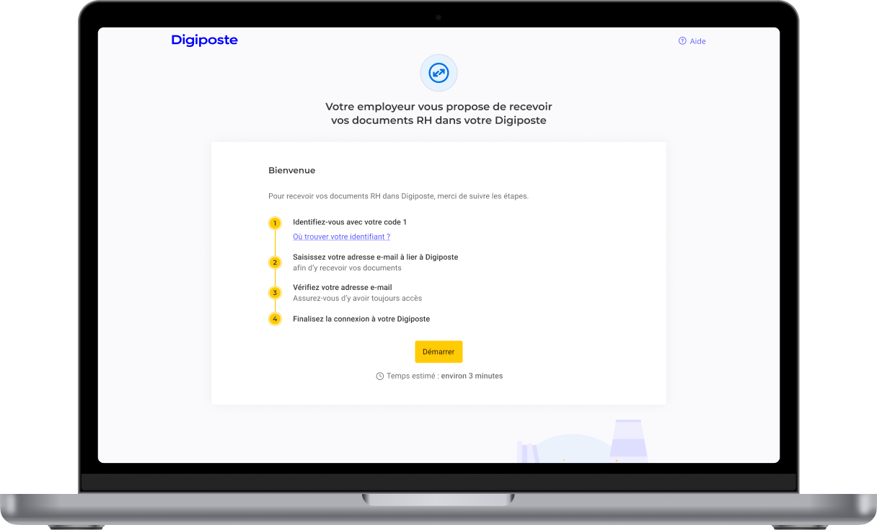
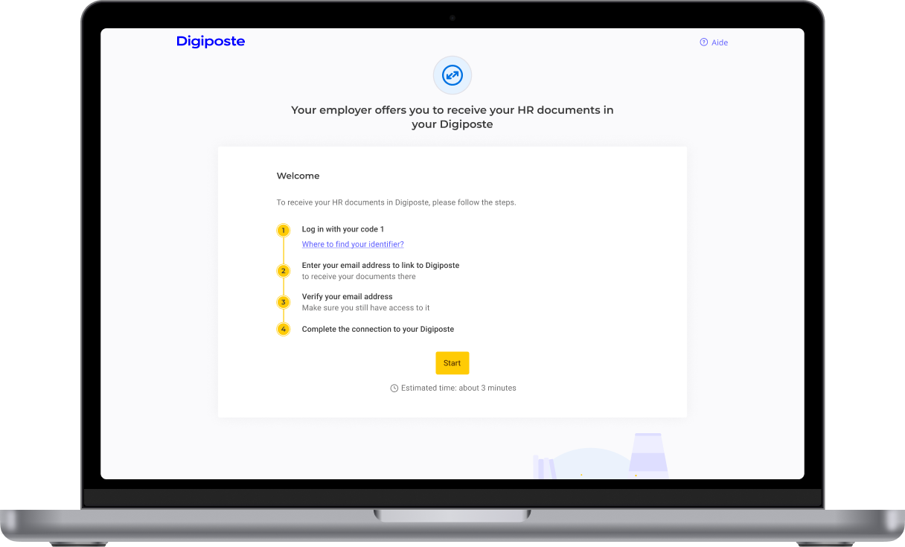
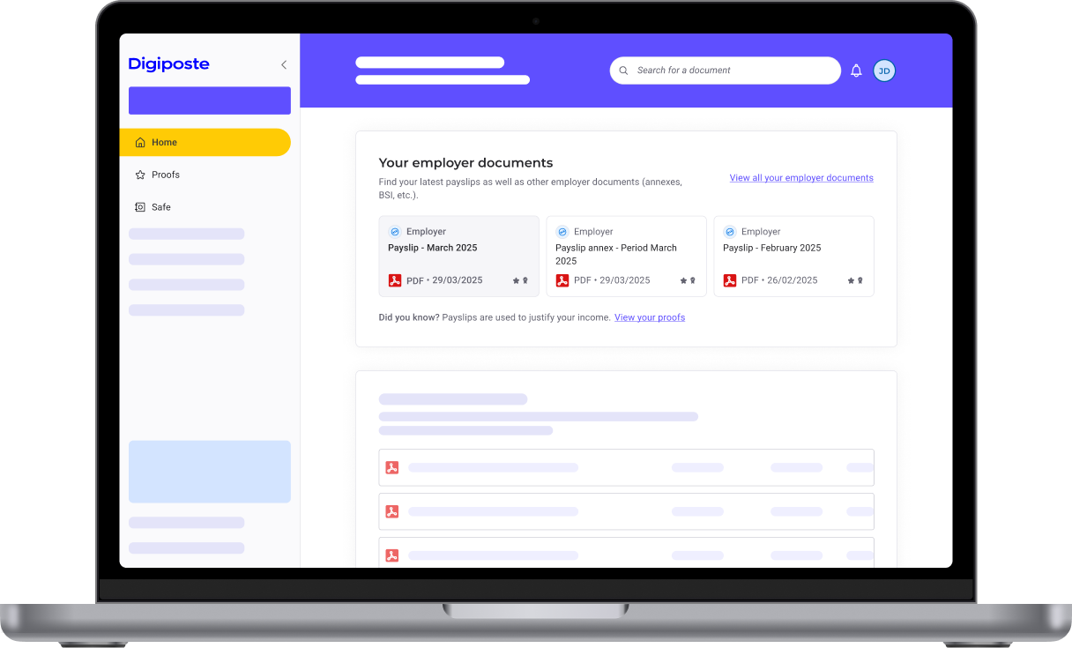
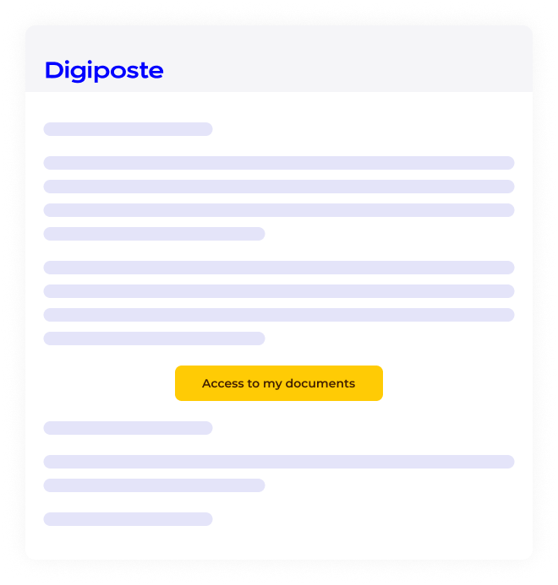
A simple process for retrieving payslips
1. Invitation
2. Registration
3. Discovery
Employees follow the steps to activate their digital safe from the Digiposte invitation they receive by e-mail.
They log in with the information previously communicated by your teams (code 1 / code 2).
Registered employees can find all the documents you've deposited in their digital safe.
They can also register from the URL dedicated to your company: https: //adherer.digiposte.fr/nomentreprise
Digiposte encourages the use of a personal e-mail address when registering for the service.
Each time a deposit is made in the safe, employees receive an e-mail notification!

Slide 7
What are the benefits for your company?

Slide 8

Benefits for your company
You're meeting employee expectations
You benefit from a secure solution
64%* of unsolicited employees say they would accept to receive a digital version of their payslip if their employer asked them to.
Digiposte is a long-term offering from La Poste and is certified as a digital safe.
Achieve economies of scale
You guarantee legal compliance
In money and time, compared to costly and time-consuming delivery by mail.
Benefit from archiving with probative value for a period that complies with legislation.
You ensure document distribution
Benefit from a 100% guarantee that your documents will be delivered to the right recipient, and you'll have proof of delivery.
*Source: Opinion Way for Digiposte - 2024

Slide 9

What are the differences between printed and digital?
Up to 70% savings on each digital delivery
tt | Printed payslip (delivery by post) | Digital payslip (delivery by Digiposte)
Confidentiality
Official and compliant
Delivery times | 4 days on average | Same day or next day delivery *
Accessible 24/7
Hosted for life in a secure account
Secure third-party sharing at the click of a button
Access from computer, tablet or smartphone
(*: according to delivery time, SLA: delivery within 8 hours).

Slide 10
What are the benefits for your employees?

Slide 11


A digital space to make administrative procedures easier
A personal digital safe free of charge with storage capacity of 5 GB storage capacity
What happens if the employee moves to another company?
Their Digiposte account follows them everywhere!
They will continue to have access to their safe and payslips at all times.
This is why Digiposte recommends using a personal e-mail address when activating the digital safe.
Documents are automatically filed in the dedicated folder
A notification is sent each time a document is filed by the employer
A secure solution, 100% hosted in France to centralize all their important documents

Slide 12
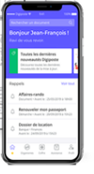
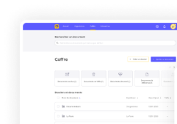

Digiposte, more than just payslips!
Digiposte allows your employees to enjoy the following benefits:
Automatically sent and received the same day
Do your employees need their documents for administrative procedures?
Delivery by post takes an average of 4 days.
With Digiposte, they can find all their documents wherever they are, 24/7.
Centralization of important documents
Bills, ID, driver's license, etc.
Preparing administrative procedures
Renewal of identity documents, rental applications, mortgages, etc.
Using the mobile app
Using the website
Sharing documents with a third party
By selection or via trusted contacts.

Slide 13
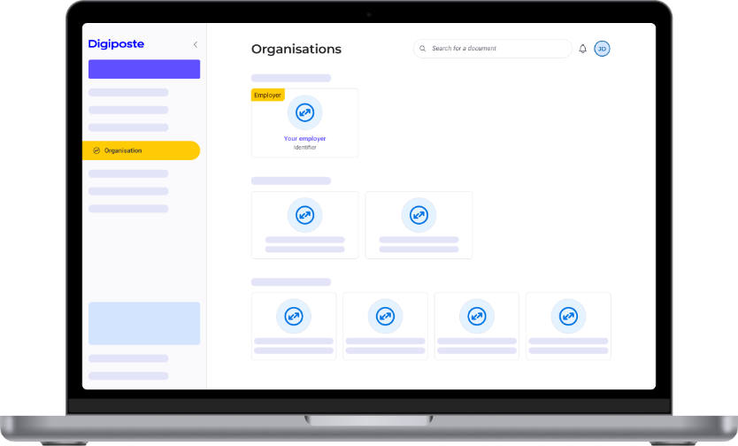
Automatic document reception
Your employees can retrieve, store and consult their personal documents from their Digiposte.
How does it work?
Your employees can connect organizations to receive documents automatically from their departments and suppliers in their Digiposte.
Once connected, they will be notified of each new document received from their organization.
Are their children's transcripts on Pronote?
They can also be automatically archived in Digiposte

Slide 14



In short, how does Digiposte simplify administrative procedures for employees?
Secure document centralization
Payslips, licenses, IDs, invoices, guarantees, proof of address, etc.
What should you do if your employees have questions about their Digiposte digital safe?
See our online guide: https://aide.digiposte.fr/
Ask a question to the Digiposte chatbot
Make sure they have the information they need to activate their account (code 1 / code 2), and pass it on to local HR
Contact Digiposte customer service using the contact form: https://aide.digiposte.fr/contact or by phone (fees apply)
Accessible anytime, anywhere
Moving house, fire, lost document, defective document, foreign travel, etc.
Save time on administrative procedures
Tax returns, mortgages, preparing for retirement, APL applications, etc.

Slide 15
Support throughout your project

Slide 16
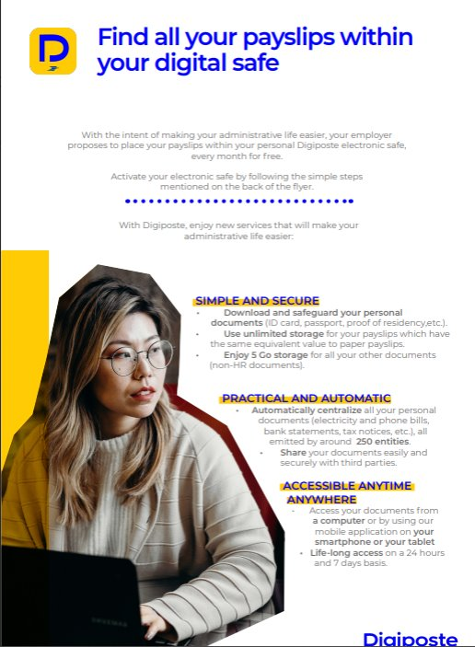
How can you support your employees?
Digiposte offers communication kits for employees to ensure greater acceptance of the solution.
Benefit from reassuring, positive communication that inspires desire.
A detailed step-by-step guide to help them on their way.
Avoid contacts between employees and HR by communicating all the necessary information in advance.

Slide 17
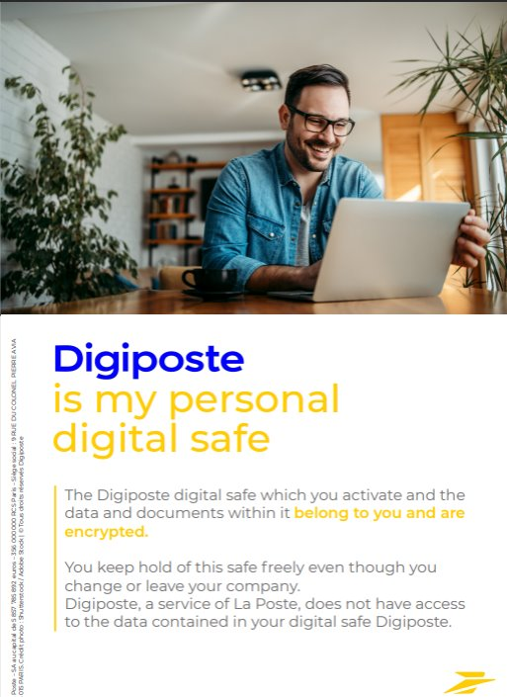
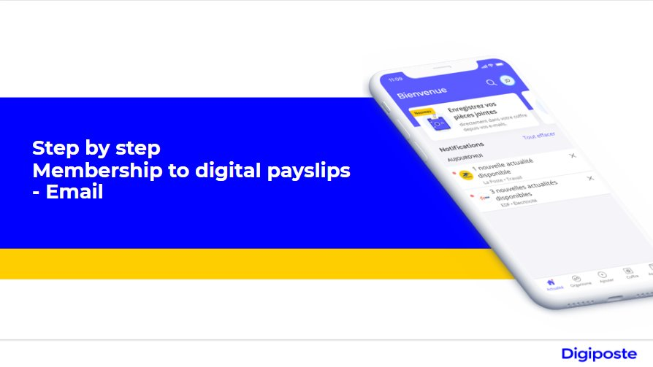
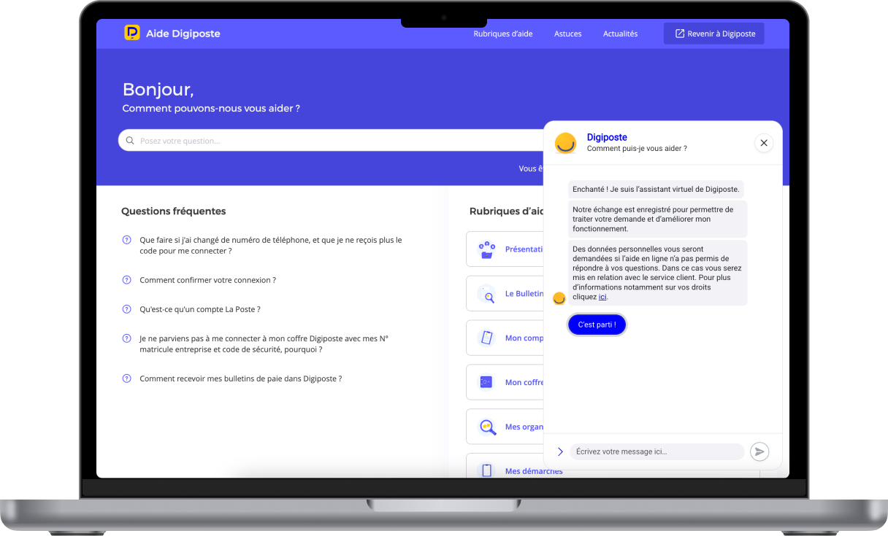
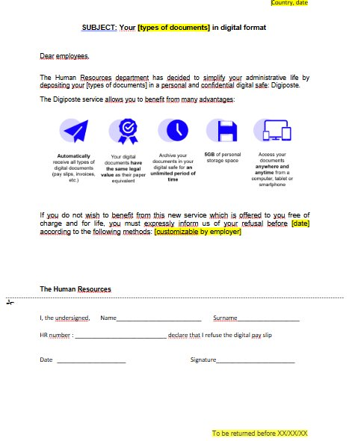

Details of the support package for your employees
Assistance
Free standard communication kit
Company help site
Posters
Employee assistance website
Refusal form
Chatbot
Flyer
Contact form
Tutorial

Slide 18
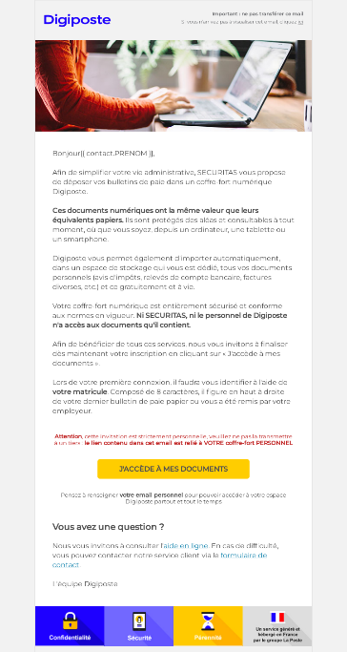
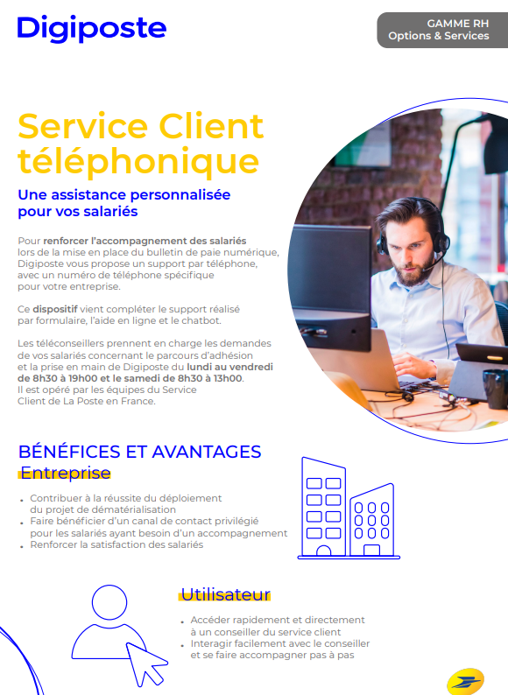
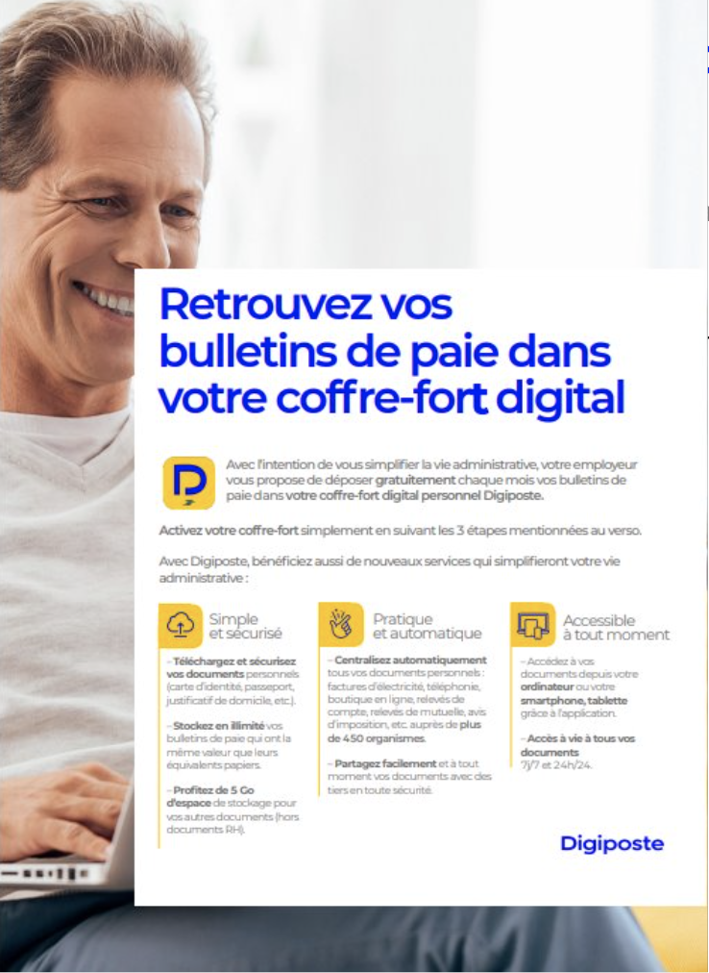
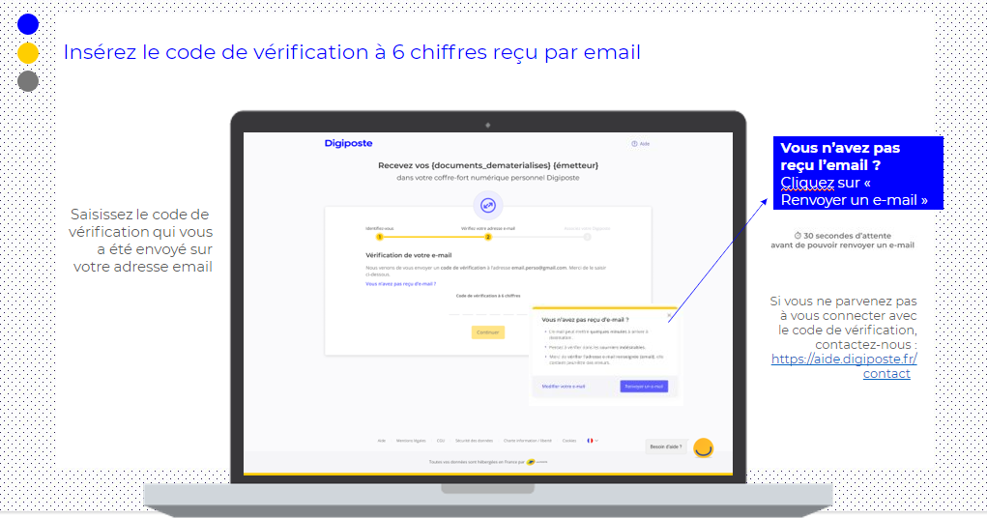
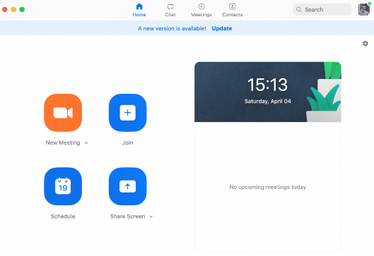
Taking support for your employees a step further
Objective: Offer a support service tailored to your company's needs
Email
made-to-measure
Hotline
customer service
Flyer
Tutorial
Dedicated
webinar

Slide 19
What support do you need as an employer?
With the Digicoach option, you benefit from our services to help you make your HR document digitization project a success.
What is the Digicoach option for?
PAID SUPPORT
Benefit from experience feedback and a proven support methodology.
Our experts are there for you
in the change management and communication stages of the project to ensure successful deployment.
Remove the hurdles to adopting the digital payslip with the help of a deployment kit provided by Digiposte.
Optimize your HR marketing by highlighting the benefits of the service.
Identify the most effective channels and ensure quality communication.

