Slide 1

Simplify your administrative procedures with Digiposte
2025 presentation

Slide 2


Your payslips are in Digiposte
Digiposte is the tool that lets you centralize your important documents and make your administrative procedures easier.
This is why your company has chosen to deposit your payslips each month, your payslips in Digiposte.
Neither Digiposte nor your employer has access to your documents!

Slide 3



What are the advantages of Digiposte?
Simple​
Secure
Confidential
Digiposte makes it easy to centralize important important documents in a digital safe.
Digiposte connections are secured with anti-intrusion systems and two-factor authentication.
Service managed by La Poste which guarantees hosting 100% in France, security, durability and confidentiality of documents

Slide 4
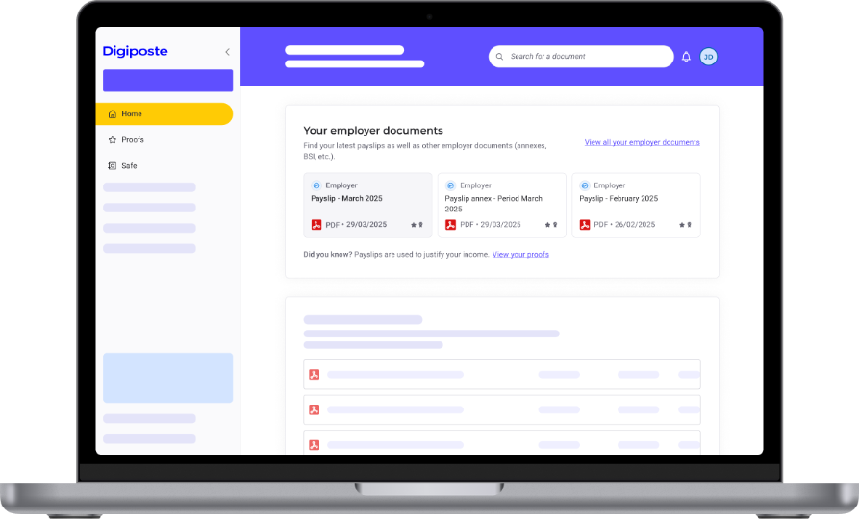

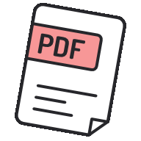

Original documents received
Your documents received in your digital safe have the same value as a printed document and include:
A level of certification​
Certified (original document with identified sender) or uncertified (manual addition by user).
A document format​
Payslips are PDF documents. You can also add other document types.
Document details
Employer name, filing date, document title, weight and type of document.

Slide 5
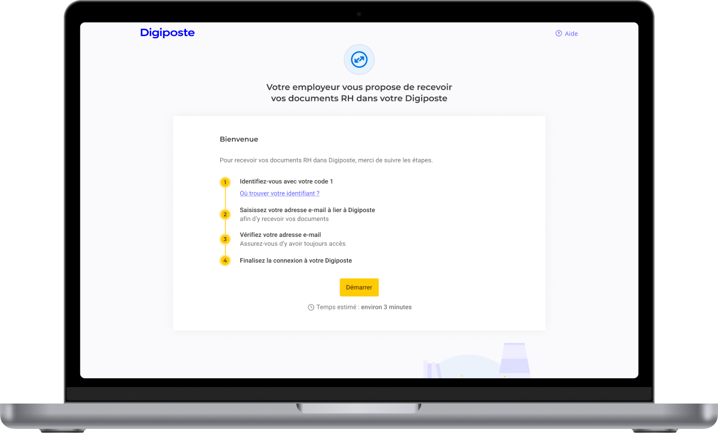
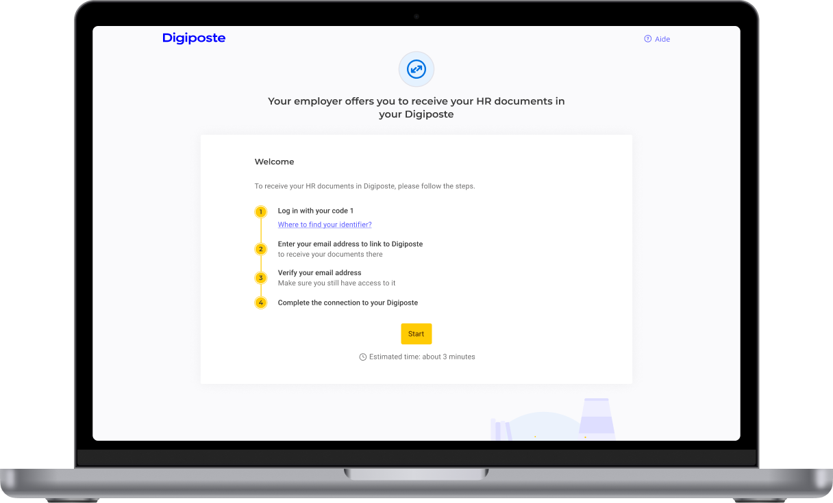
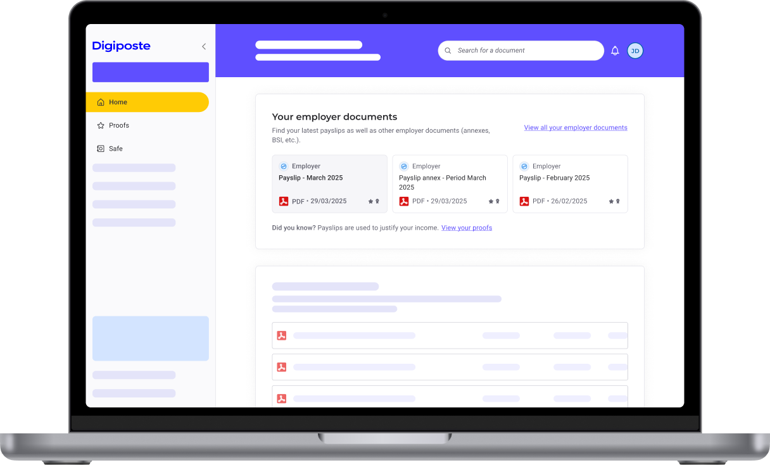
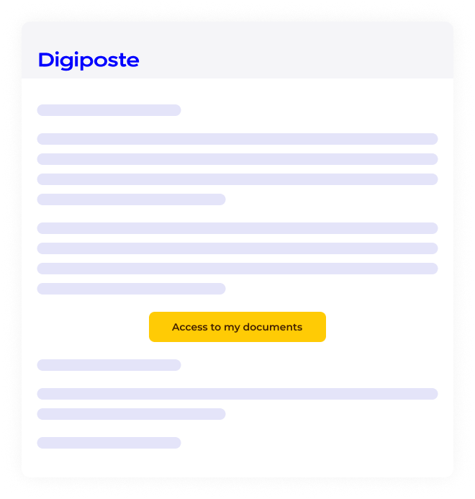
A simple process for retrieving your payslips
1. Invitation
2. Registration
3. Discovery
Follow the steps to activate your digital safe from theDigiposte invitation you receive by e-mail.
Log in with the information previously provided by your employer (code 1 / code 2).
Find all the documents deposited by your employer in your safe.
Or go directly to the URL dedicated to your company: https: //adherer.digiposte.fr/nomentreprise
We recommend that you use your personal e-mail address to register for Digiposte.
Each time a document is deposited in your Digiposte, you'll receive an e-mail notification.

Slide 6
What are the benefits for you?

Slide 7


A digital space to make your administrative procedures easier
A free-of-charge personal digital safe with a 5GB storage capacity
What happens if I move to a different company?
Your Digiposte follows you everywhere! You'll continue to have access to your safe and payslips at all times.
We therefore recommend that you use a personal e-mail address when activating your digital safe.
Your documents automatically filed in a dedicated folder
A notification is sent each time a document is filed by the employer
A secure solution, 100% hosted in France to centralize all your important documents

Slide 8

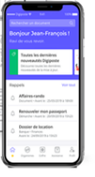
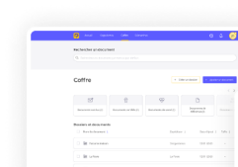

Digiposte, more than just payslips!
Centralize your important documents
Bills, ID, driver's license, etc.
Do you need your documents for administrative purposes?
Prepare your administrative procedures
With Digiposte, you can find all your documents wherever you are, 24/7!
Renewal of identity documents, rental applications, mortgages, etc.
Share your documents with a third party
By selection or via trusted contacts
Using the mobile app
Using the website
Scan your documents with the mobile scanner
or e-mail your documents directly to Digiposte.

Slide 9
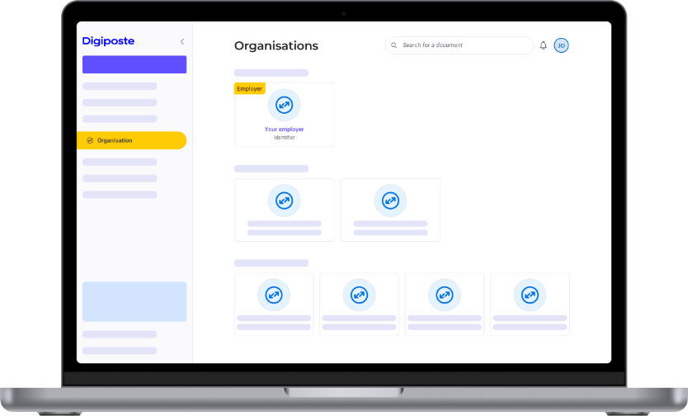
Automatic document reception
You can retrieve, store and consult your personal documents using Digiposte.
How does it work?
Connect your organizations to receive your documents automatically.
Once logged in, you'll be notified each time a new document is received.
Are your children's transcripts on Pronote?
You can also archive them automatically in Digiposte.

Slide 10



In short, how does Digiposte simplify your administrative procedures
All your documents grouped and secured
Payslips, licenses, ID, invoices, warranties, proof of address, etc.
What if you have questions about your Digiposte digital safe?
See our online guide: https://aide.digiposte.fr/
Ask a question to the Digiposte chatbot
Contact your HR representative for further information
Contact Digiposte customer service using the contact form: https://aide.digiposte.fr/contact
Accessible anytime, anywhere
Moving house, fire, lost document, defective document, foreign travel, etc.
Save time on administrative formalities
Tax returns, mortgages, preparing for retirement, personal housing allowance applications, etc.

